Slide 1

The Rotary Foundation of Rotary International
Notes:
Thank you for inviting me to talk about The Rotary Foundation. The Rotary Foundation (TRF) is one of the premier charitable organizations in the world. TRF receives a 4-star highest rating from Charity Navigator, America’s largest independent evaluation of charities. TRF was established in 1917 and has been ‘doing good in the world’ ever since.

Slide 2
RI Mission Statement
The mission of Rotary International, a worldwide
association of Rotary Clubs, is to provide service to others, to promote high ethical standards, and to advance world understanding, goodwill, and peace through its fellowship of business, professional and community leaders.
“Service Above Self”
Notes:
TRF belongs to Rotary International, and Rotary International’s mission is to PROVIDE service. We have been around since 1905 helping people in our local community as well as around the world. As you know, we Rotarians believe in “Service Above Self”.

Slide 3
TRF Mission Statement
The mission of the Rotary Foundation is to enable Rotarians to advance world understanding, goodwill and peace through the improvement of health, the support of education and the alleviation of poverty.
“Doing Good in the World”
Notes:
Whereas, the mission of TRF is to ENABLE Rotarians to have the means to provide that service. It is our contributions that give TRF the ability to fund many of the service opportunities that Rotarians perform around the world. Where we Rotarians seek to provide a service project that benefits mankind, TRF ENABLES us to fulfill that service project with funding.

Slide 4
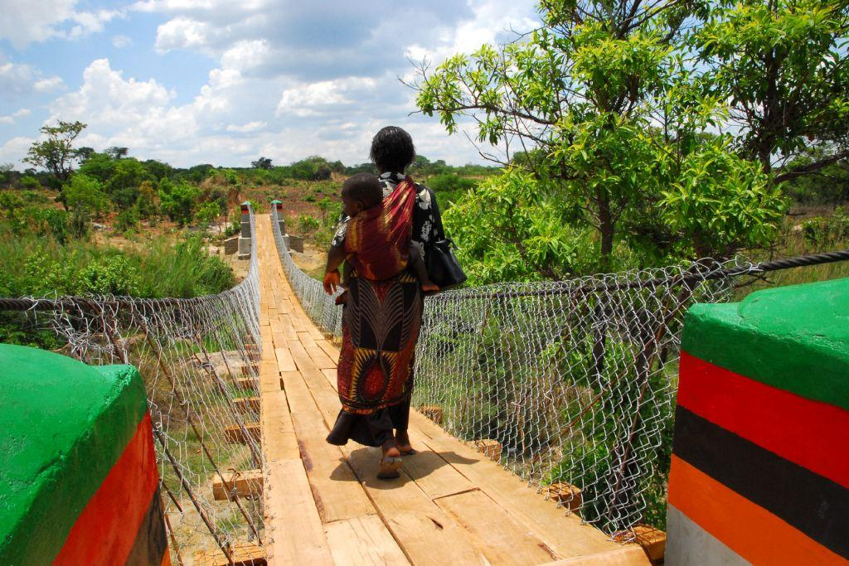
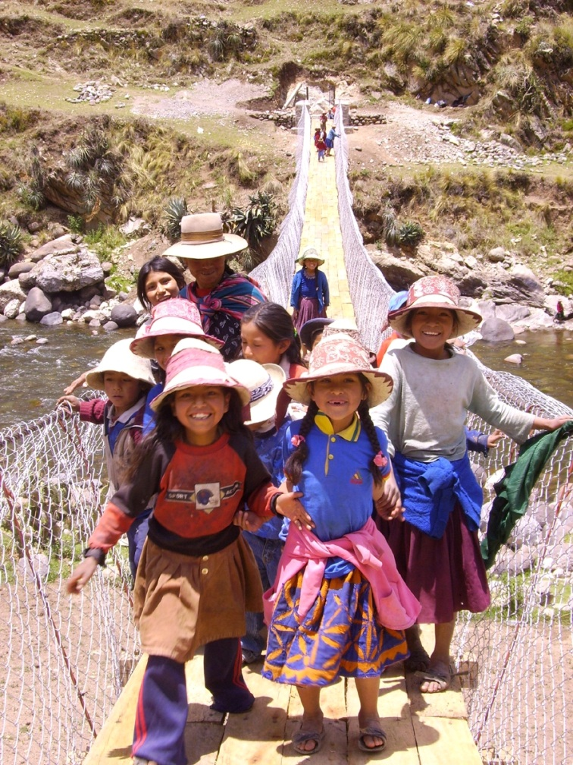
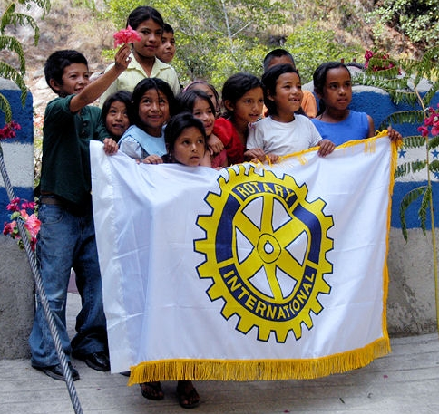
If you want to help build bridges!
Notes:
If you want to help do good in the world, then you should understand WHY we Rotarians give. We give because we believe in the good that it does for others less fortunate that us. So if you want to help build bridges to help connect people and services, then you can do so as a Rotarian through TRF.
We are known for the service that we provide around the world…….. As in this Bridges to Prosperity service project in Honduras and other countries that the Newport News and Warwick Rotary Clubs, as well as many other District 7600 Rotary Clubs, have participated.

Slide 5
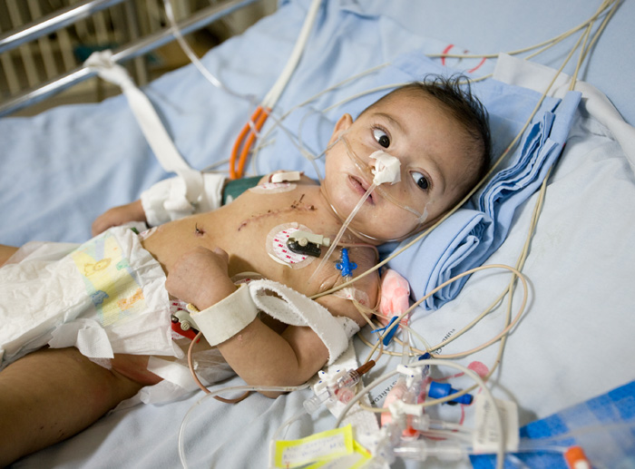
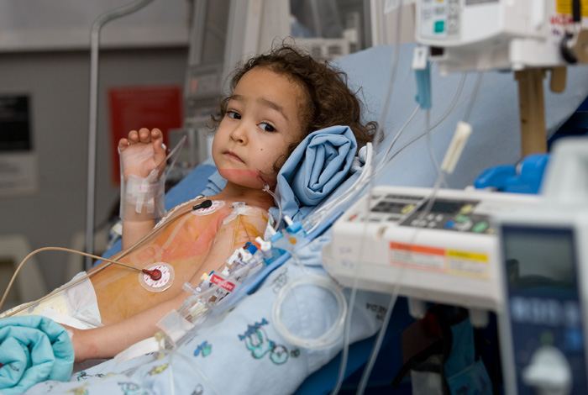
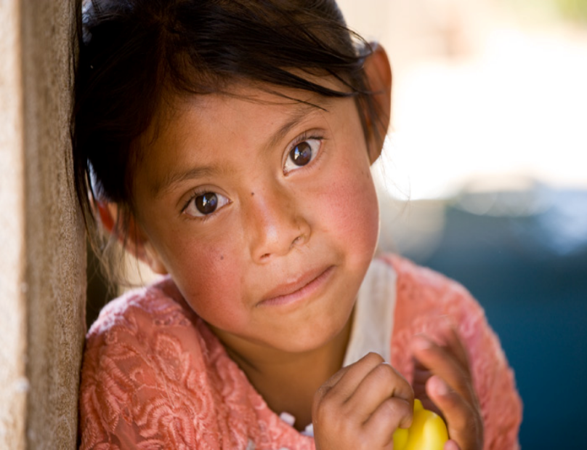
If you want to help heal hearts!
Notes:
Maybe you want to help heal young children with heart defects. You can do that through TRF because you understand WHY the contributions you give can be used by physicians who give their time and skills to healing hearts and saving lives. Rotarians in Suffolk, South Richmond, Innsbrook, Richmond, Huguenot Trail and Bon Air Rotary Clubs understand WHY their giving is important to these children.

Slide 6
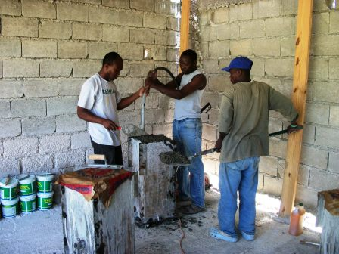
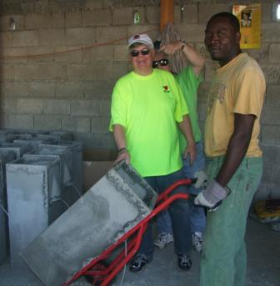
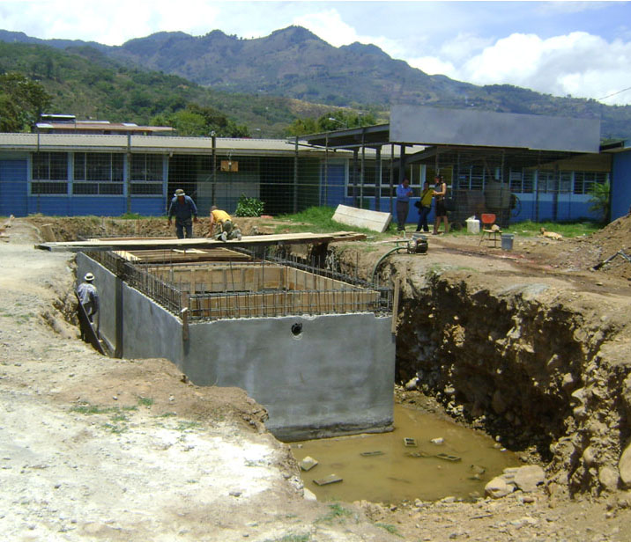
If you want to help make clean water!
Notes:
Rotarians understand the importance of clean water to good health and prosperity. And they understand WHY giving to efforts that bring access to clean water and sanitation facilities leads to a better life. Several of our Rotary Clubs – Virginia Peninsula, Blackstone, South Hill, Powhatan, Henrico East – have helped bring clean water to remote areas of the world, such as these two water projects in Costa Rica and Haiti.

Slide 7
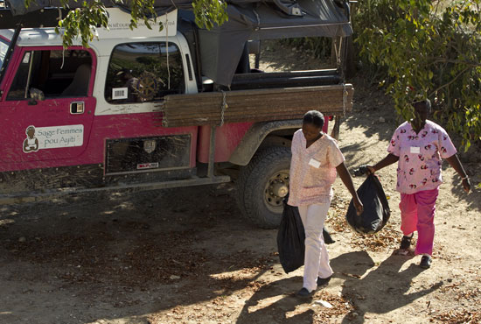
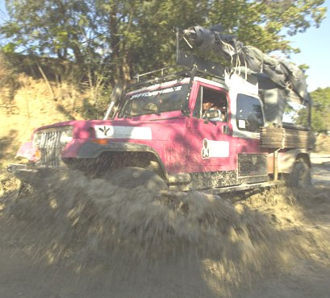

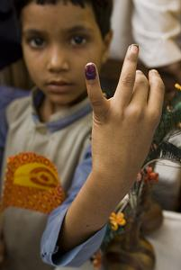
If you want to help deliver healthy babies!
If you want to be ‘this close’ to eradicating Polio!
Notes:
Delivering healthy babies is also pretty important. This mid-wife’s jeep in Haiti was provided by the Rotary Clubs of Western Henrico, Bon Air and Henrico East to enable these women to move about the countryside delivering precious little bundles of joy. That’s a good reason to believe that TRF ‘does good in the world’.
Speaking of good in the world, Rotary is ‘this close’ to eradicating Polio because we believe that WHY we give can have a significant impact in the world. Eradication of Polio will be a truly signature event made possible by the contributions of millions of dollars by our Rotarians.

Slide 8
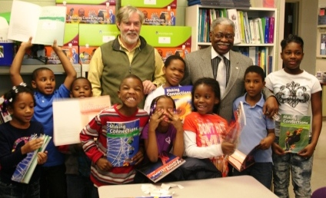
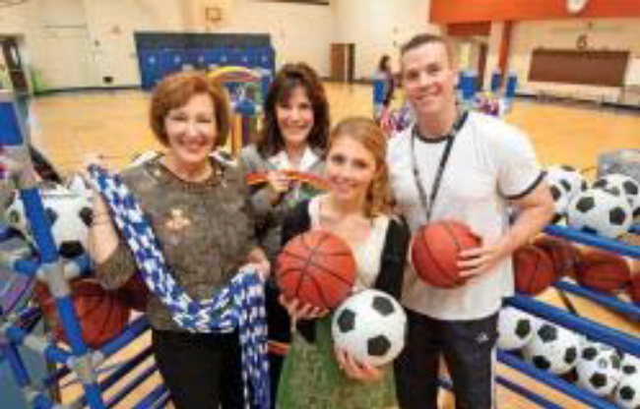
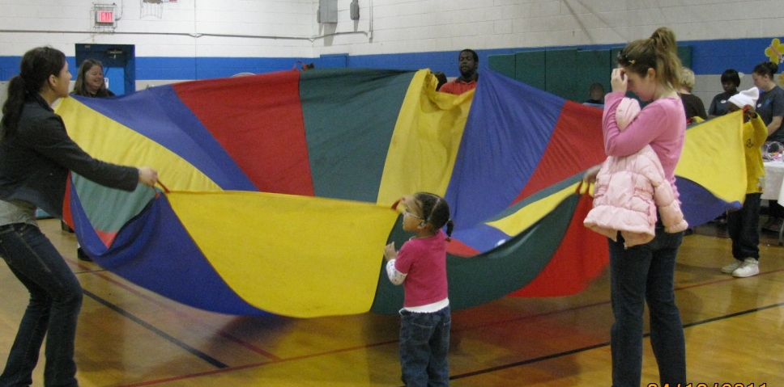
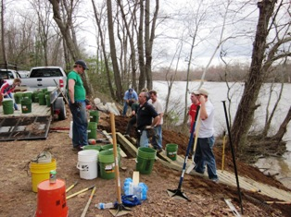
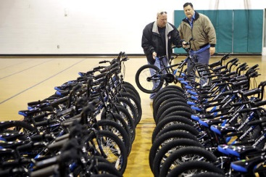
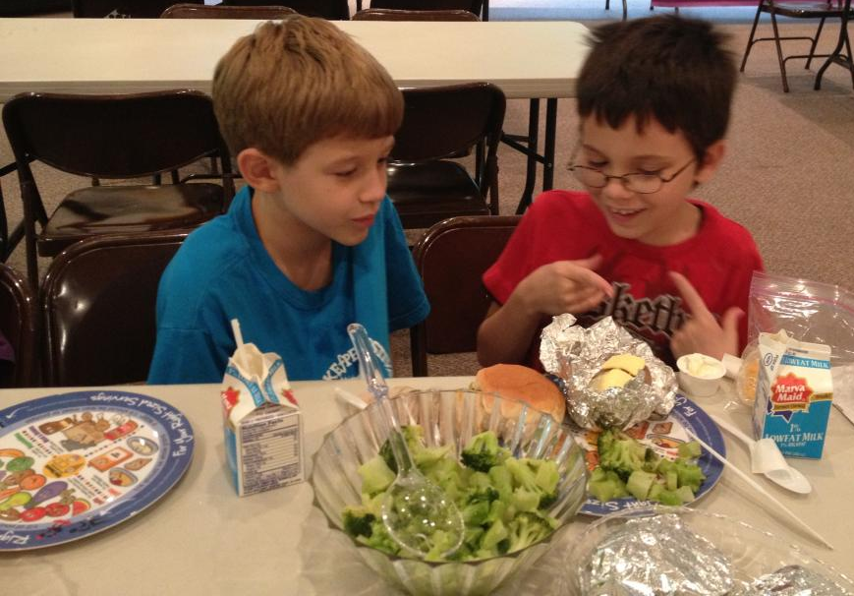
If you want to help your community with District Grants
Notes:
You don’t have to go overseas to believe in WHY we contribute to TRF. You can see firsthand the work that your contributions do right in your community. We use some of our Foundation funds to give District Grants to our Rotary Clubs to do service projects right where they live. Here you see some of our Rotary Clubs in Action: Western Henrico & Short Pump helping a literacy project in Peter Paul Center, Bon Air and Midlothian buying sports equipment for the Falling Creek School and Prince George doing a bit of clean-up in their community. Also a lot of goodwill was created by Oyster Point’s YMCA Bikes and Nutrition for Kids project.

Slide 9
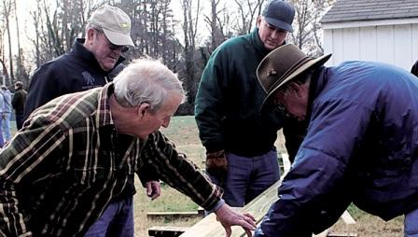
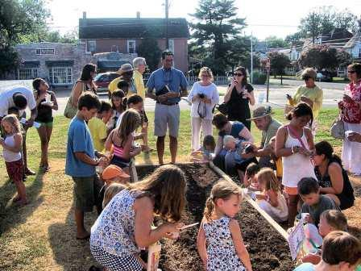
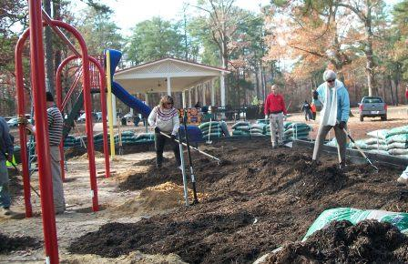
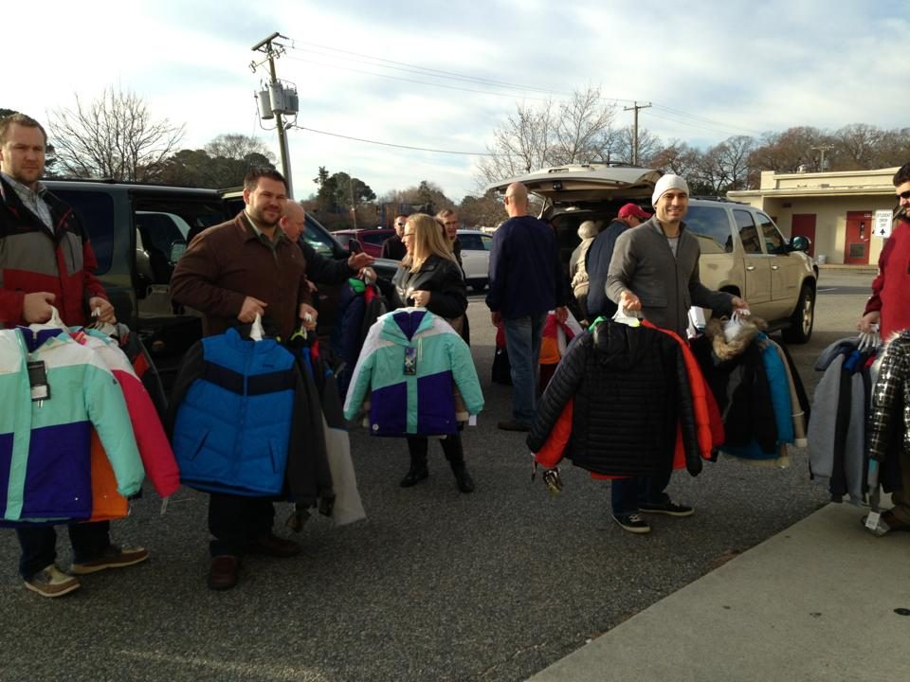
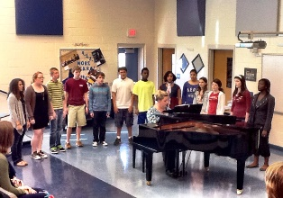
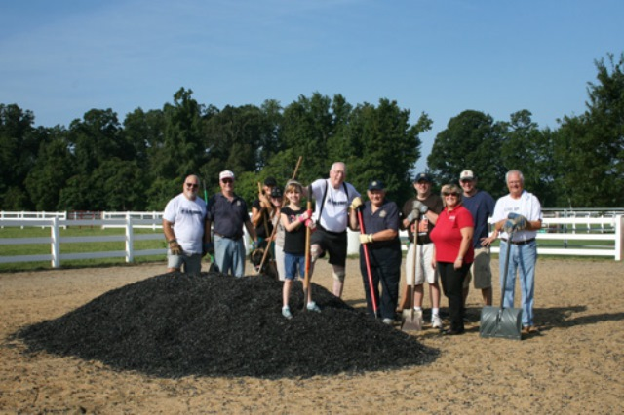
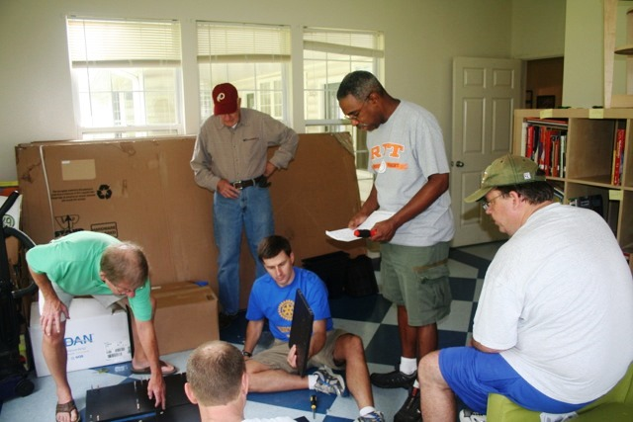
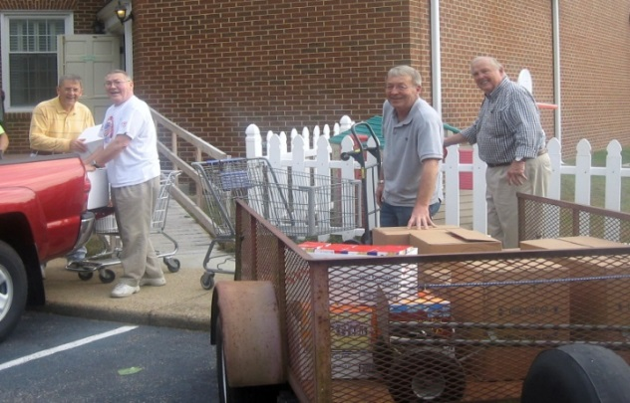
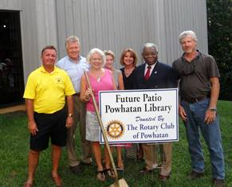
If you want to serve……
Notes:
Every year, our Rotarians look for ways to serve. They believe in the good that TRF brings. Whether you are in North Suffolk working on a baseball field,, or Cape Charles mentoring a Youth Garden, or several Petersburg Rotary Clubs upgrading a playground, We enjoyed providing Coats for Kids with the Chesapeake Rotary, or working with Innsbrook Rotary on the Boys-Girls Club, or listing to the piano that New Kent Rotary purchased for the local high school or spreading the mulch with The Historic Triangle Rotary with the Dreamcatchers Organization, or helping Yorktown Rotary add shelving to the local Food Closet, or building a patio for the Powhatan Library. Rotarians are active in their community helping meet the needs of people they know.

Slide 10

IF YOU WANT:
Stronger clubs
Increased contributions
Better projects
Greater impact
Enhanced public image
Greater global reach
Increased membership and donor base
Notes:
So, when we look at WHY we give and what we get in return, I think you will understand that “doing good in the world” also makes us a better organization. With stronger, more innovative, and more flexible clubs, come better brand awareness and public image. With better service projects that are more focused and have a greater long-term impact, comes more interest in joining the efforts of our clubs—through membership, contributions, and collaboration in our service efforts
Ultimately, all these outcomes are a result of the efforts of our clubs and districts to do things a bit differently and keep up with the demand of the communities we serve both locally and globally.

Slide 11

If this is WHY you believe, then be a part of….
The Rotary Foundation
To make a difference
To be part of something bigger than yourself
To leave a legacy
To take ownership of ‘your’ Foundation!
Notes:
By believing in The Rotary Foundation, you can truly make a difference, you can be part of something bigger than yourself and you can leave a legacy for others.

Slide 12


Over the last three years, District 7600 has given in contributions to TRF……
Over $2 million
Over the last three years, Rotarians world-wide have given in contributions to TRF……
Over $650 million
Notes:
Our Rotary Clubs have been good stewards of TRF. Over the years, we have given generously of ourselves to better mankind. D7600 ranks in the top 10% in giving of the over 500 Rotary Districts in the world. In just the last three years, our giving has totaled over $2 Million. Last year, we set a District giving record of $175.00 per capita. As an organization, Rotarians have contributed over $650 Million to enable Rotary to provide “Service Above Self”.

Slide 13




Foundation Funds
Support for the Foundation programs comes from:
  Annual Fund
  For Support Today
  Endowment Fund
  To Secure Tomorrow
  PolioPlus Fund
Notes:
When we give to TRF, we can contribute to one of three funds depending on what we want that money to do. If we contribute to the Annual Fund, we use that money to enable service projects to be accomplished. These funds operate our Foundation from year to year.
If we contribute to the Permanent Fund, now called the Endowment Fund, we are wanting that money to be held in perpetuity as an endowment, whose interest is used to enable projects to be accomplished.
We can also contribute funds directly to Polio to help us eradicate that terrible disease. These funds, along with funds from other partners including the Gates Foundation, are used to get us “this close” to achieve the certification of polio eradication by the end of 2018.

Slide 14

Do you know about….?
Paul Harris Fellow, Rotary Foundation Sustaining Member, Every Rotarian-Every Year, Paul Harris Society, Major Donor
Benefactor, Bequest Society
End Polio Now Campaign
Notes:
Let me ask you ………… What do you know about???
Paul Harris Fellow….. Anyone who contributes $1,000 to TRF
Rotary Foundation Sustaining Member ………. Anyone who contributes $100 or more each year to TRF
Every Rotarian, Every Year……….. Annual campaign EREY to encourage Rotarians to give….. Normally conducted in November
Paul Harris Society………… A Rotarian who gives annually $1,000 to TRF may join the PHS
Major Donor ………. A Rotarian who has given $10,000 or more to TRF
Benefactor………….. A Rotarian who has pledged or given $1,000 to the Endowment Fund, usually as an insurance policy
Bequest Society……… A Rotarian who has pledged or given $10,000 or more to the Endowment Fund, usually as an Insurance policy.
End Polio Now Campaign…………. Part of the Gates matching funds. A Rotarian who gives to the PolioPlus campaign.

Slide 15
SHARE: Foundation Donation Flow
$
$492 in 2012-13
2013-14
2014-15
2015-16
$
$246,000
$246,000
50% to District Designated Fund
50% to World Fund
$122,800
$122,800
Matches 1:1 DDF $
and 50% of cash $
Up to ½ to
District Grants
(No TRF Match)
At least ½ to
Global Grants
Notes:
You might want to know what Rotary does with the money you contribute………….
First of all, the money contributed to the Annual Fund is invested for three years and the interest is used to continue operations. After three years, that amount contributed, in this case, D7600 contributed about $500,000 in 2010, is returned for use in service projects. That contribution is available in 2013.
Of the $500,000, one half comes back to D7600 as District Designated Funds to use for District Grants and Global Grants. The other half, $250,000, is available in the World Fund, which can be used to match requests for Global Grants or other purposes. D7600 can use up to ½ of their DDF for District Grants ($125,000) and the remainder for Global Grants. DDF that is used for Global Grants is then matched with money from the World Fund. In that way, a $15,000 of DDF used in a Global Grant can quickly become a $30,000 service project somewhere in the world.

Slide 16






Areas of Focus
  Peace and Conflict Prevention / Resolution
  Disease Prevention and Treatment
  Water and Sanitation
  Maternal and Child Health
  Basic Education and Literacy
  Economic and Community Development
Notes:
16
The Rotary Foundation has identified six areas of focus for those projects and activities requesting funding via global grants. These areas reflect critical humanitarian issues and needs that Rotarians are already addressing worldwide.
They align Rotary with other international development efforts and will strategically further the Foundation's mission. Each of the areas has specific goals associated with the area.
D7600 is also using these six areas of focus as a criteria for approval of a District Grant. In order to get a District Grant, a club must show that their service project falls within one of these focus areas.

Slide 17
In the last three years, District 7600 has received and spent over $770,000 in TRF grant funds for service projects throughout the world……
“Doing Good in the World”
Notes:
Over the last three years, D7600 has an excellent record of using our District Designated Funds to provide for service projects both locally and international…… Last year, for example, we used about $46,000 to give grants to our clubs to use locally, another $54,000 for Ambassadorial Scholars, $50,000 to PolioPlus, and another $100,000 for Matching Grants for a total of over $260,000. Our Rotarians worked service projects in Sudan, Brazil, Lithuania, El Salvador, Haiti, Rwanda, and India.
This year, we have just sent about $90,000 in District Grants to about 20 Rotary Clubs to use on local service projects to help people in need in Chesapeake, Exmore, Franklin, Hopewell, Lawrenceville, Newport News, Petersburg, Powhatan, and other areas. Hopefully we will soon be working with several Clubs to sponsor Global Grants, including Vocational Training Team and Scholars.

Slide 18
District Grants
Educational and humanitarian activities consistent with the mission
Single “block” grant awarded annually
Smaller activities and projects
Local or international activities
District 7600
$5,000 maximum per club, must be aligned with area focus
(up to $25,000 by partnering with other clubs)
Notes:
18
District grants support the overall mission of The Rotary Foundation, but allow for a broad range of choices for clubs and districts.
The district can apply annually for one district grant – a “block grant” so to speak – for up to 50% of its available District Designated Funds for that Rotary year - after collecting requests from its clubs. The district then issues the money and reports to its clubs on how all of the funds were utilized.
The Foundation itself requires very minimal reporting, thanks to the advance planning done by clubs and districts before the funds are requested. This enables districts to close out their grants quickly.
District grants are intended to support smaller activities and projects both locally and internationally.

Slide 19
Global Grants
Long-term projects
Larger grant awards
Sustainable, measurable outcomes
Alignment with areas of focus
Vocational Training Teams
Scholars
World Fund match
$0.50:$1 match for club contributions
$1:$1 match for District Designated Funds (DDF)
Notes:
19
Global grants fund long-term projects and activities that are sustainable and measurable and relate to the goals of the areas of focus. In order to support these goals, global grants provide larger awards for projects and activities with a minimum World Fund award of $15,000, resulting in a total project cost of US$30,000 and above.
Clubs and districts can partner together to develop projects that incorporate humanitarian activities, scholarships, and/or vocational training teams as long as the activities relate to the areas of focus.

Slide 20
XXXXX Rotary Club
Membership: 2013-14 = XX; 2014-15 = XX; 2015-16 = XX
Annual Fund Giving:
  2015-16: Goal = $xxxxx / PolioPlus Goal = $xxxxx
  2014-15: Goal = $xxxx/Actual = $xxx(xx%) + $xxxx pp
  2013-14: Goal = $xxxx/Actual = $xxxx (xx%)+ $xxxx pp
Rotary Foundation District Grants
  2015-16: ($122,000) = ???
  2014-15: ($120,000) = ????
  2013-14: ($116,000) = ????
Rotary Foundation Global Grants
  No record of a Global Grant
Notes:
Please use this slide to customize this briefing for a particular Rotary Club. You can look up their Annual Giving and PolioPlus and you can check to see if they have sponsored any district grants or global grants. It’s always much better when you can relate directly to the club……. Noting how many PHF, PHS, Benefactors, etc that they have achieved.

Slide 21
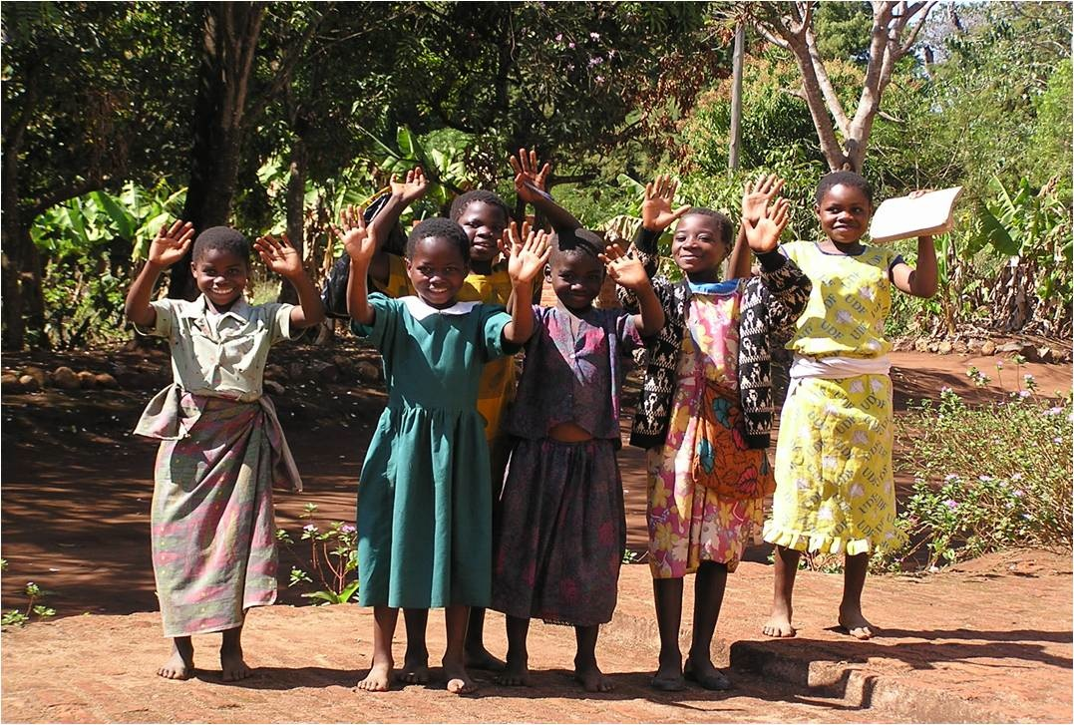
Doing Good in the World!
Notes:
When you think of The Rotary Foundation, think of WHY we contribute …….. We want to ENABLE Rotarians to provide “Service Above Self”.
And think of the happy faces that result from ‘doing good in the world’. We are truly blessed when we give to help others.

Slide 22
Every Rotarian Every Year
Notes:
In November, we will be conducting our Every Rotarian, Every Year campaign for TRF. I hope you will give to your Foundation. There are lots of people out there depending on your support.
Thank you…………. Do you have any questions?

